Slide 1
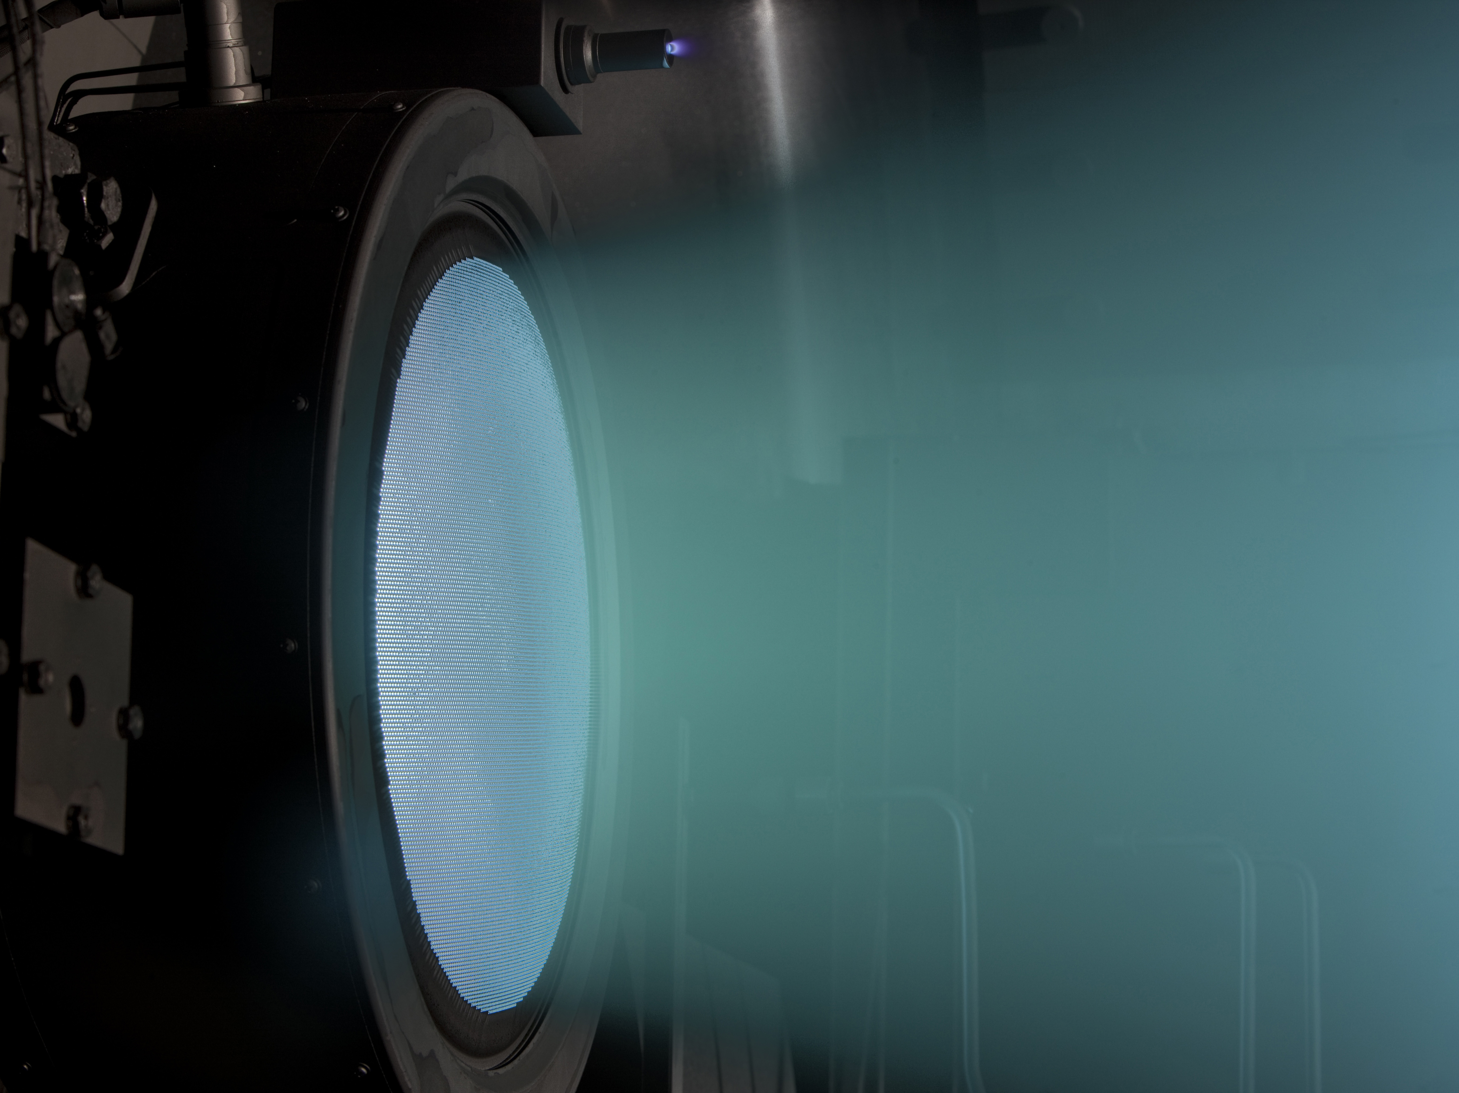
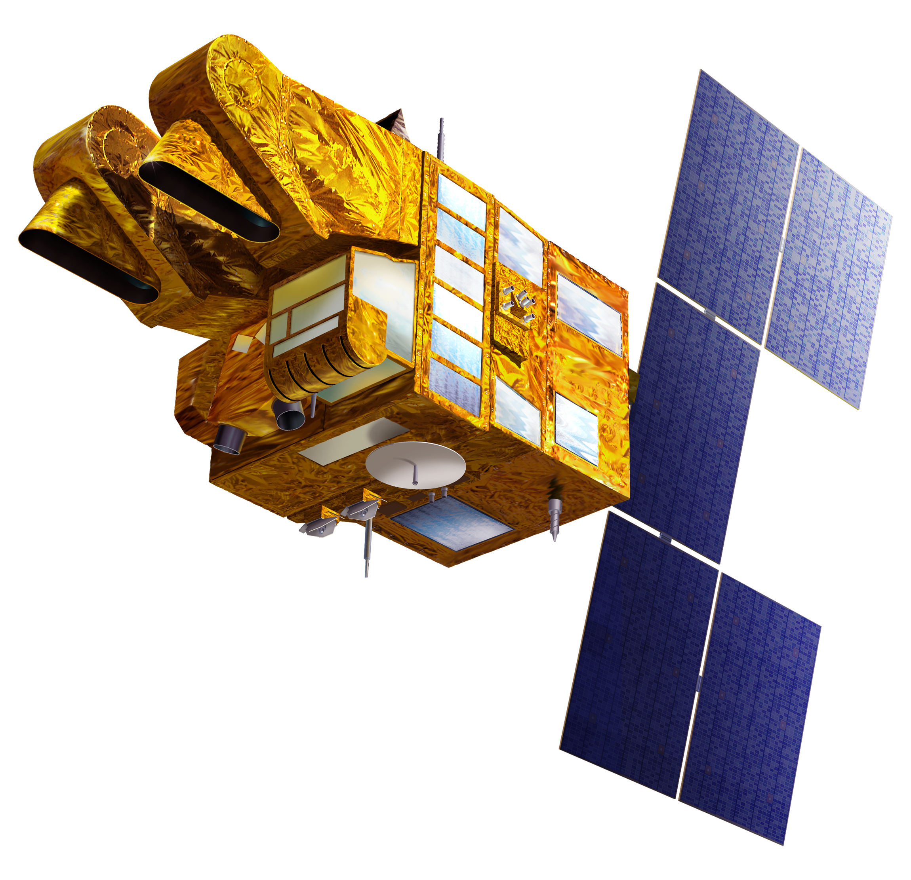
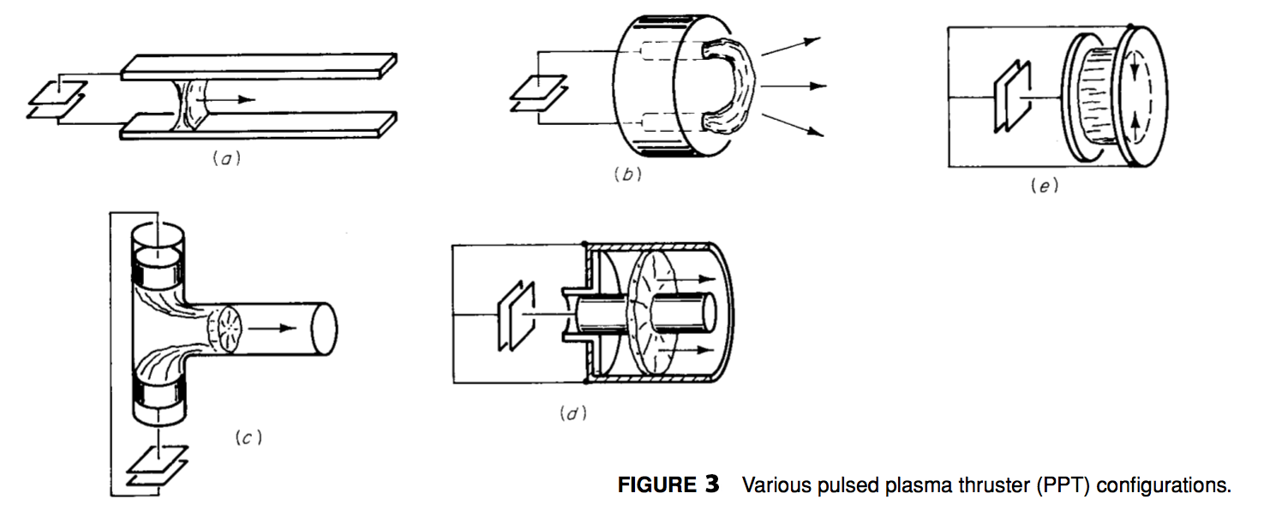
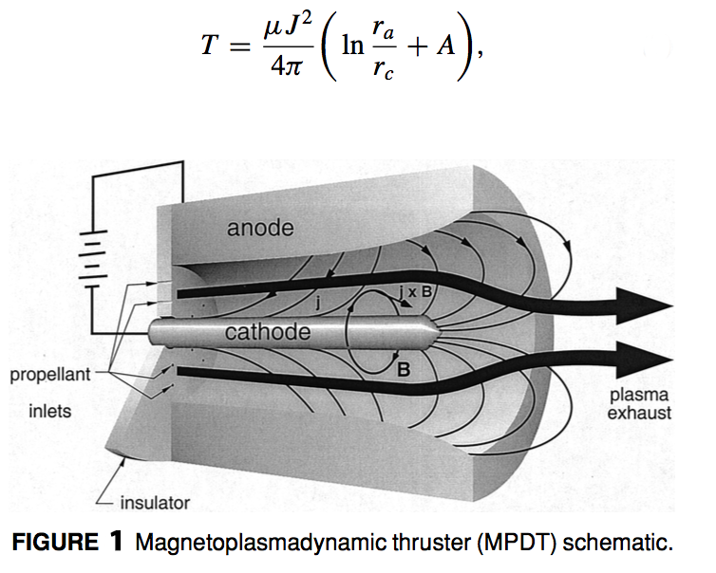
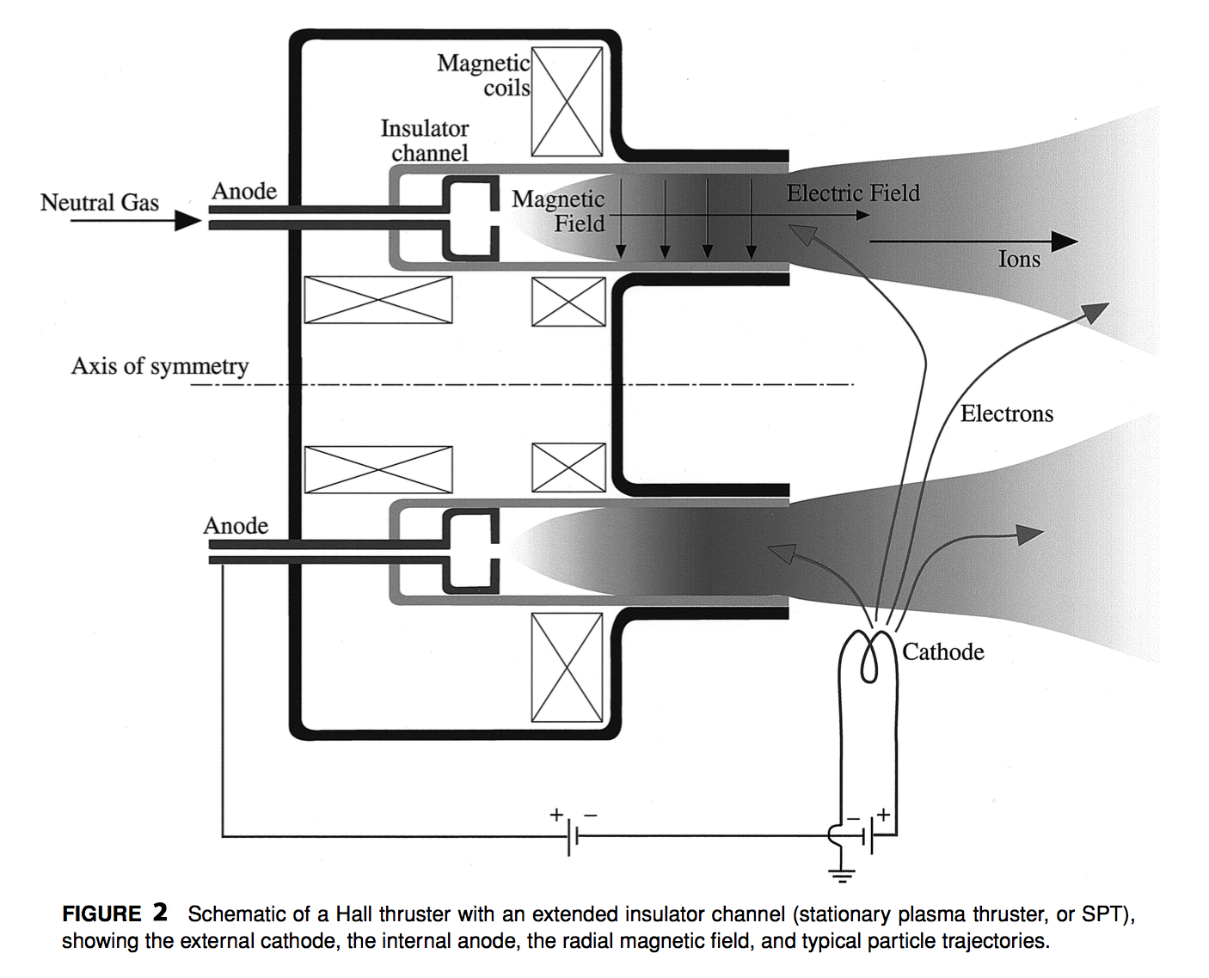
ELECTRIC PROPULSION SYSTEMS
Current Methods & Examples
Pulsed Plasma Thrusters (FIGURE 3)
Pulsed plasma thrusters are similar in function to MPDT devices, but designed for short bursts of high instantaneous power. Power is usually stored in capacitor banks or inductor coils for rapid delivery to electrodes by some form of high speed switch. Propellant is fed through the device by a ”snow-plow” like effect which increases the thrust density for a short powerful burst. Pulsed Plasma Thrusters are often used for instantaneous flight corrections such as rotational assistance and slight flightpath corrections. The PPT system was the first EP system to operate in orbit, when the 1964 Soviet Zond-2 spacecraft used six Teflon APPTs for sun pointing control, enabling the spacecraft to gather solar energy for it’s other devices.
Modern satellite which utilizes electric propulsion
Electromagnetic Propulsion
The most utilized category of Electronic propulsion relies on an electric current exposed to a conductive propellant stream with a magnetic field used to accelerate the charged propellant. These systems can produce much higher thrust densities those that utilize electrothermal or electrostatic propulsion alone.
An electrically conductive fluid, usually a highly ionized gas is subjected to an electronic field.
The electronic field creates a negatively charged plasma
Plasma is fed through a perpendicular magnetic field
The perpendicular magnetic field is charge with a positive positive charge
The positive charge accelerates the negatively charged plasma to create a streamwise body force.
This density of expelled plasma creates a thrust force which increases the velocity of the spacecraft.
Current Electromagnetic Propulsion Technologies
Electromagnetic Propulsion offers the most dynamic variety of implementations for spaceflight. A broad variety of propellant types, including liquids and solids may be used, along with numerous hardware configurations related to geometry, electrode and insulator configurations, injection techniques, and methods of ionizing and ejecting the propellant.
Magnetoplasmadynamic Thrusters (FIGURE 1)
Characteristics of MPDT devices are a coaxial geometry constituted by a central cathode, an annular anode and some form of inter-electrode insulator. Gaseous propellants are injected into the upstream portion of the channel, where they are ionized by an intense, uniform electric arc within the electrode gap. The current within the electromagnetic field exerts the forces necessary to accelerate the propellant toward the centerline of the device, where it is compressed into an extremely hot plasma. This plasma is forced through the thruster and is expanded just beyond the cathode tip, where it creates the exhaust velocity required for uniform thrust. Some limits to MPDT technologies are overall space, power supply, plasma instabilities and power usage due to erosion of the electrodes, housing and EM components. Current capabilities include impulses in the range of 1500-8000 sec with thrust efficiencies exceeding 40%.
Hall Thrusters (FIGURE 2)
Currently, Hall thrusters are the most widely applied electric propulsion devices used in electronic space flight today. These devices are used on long range probes, satellites and on the international space station. Typically “Hall Effect” thrusters are with geometries that lock plasma electrons into a nearly collision-less drift before introduction into an applied magnetic field which propels them downstream to create a low density thrust velocity which requires significantly less power than the MPD devices. Today’s Hall Thrusters are sometimes referred to as “closed-electron-drift” devices because of the drift of electrons which occurs between the introduction of the propellant into the system and the applied magnetic field. The most common Hall Devices are the stationary plasma thruster (or magnetic layer thruster) and the anode layer thruster. Current Hall Devices typically use Xenon because of the ability to readily ionize upon contact with a magnetic field.
Abstract
All spaceflight missions require onboard propulsion systems to create acceleration and velocity vectors required for space travel and operational maneuverability. These propulsion systems have a major impact on spacecraft mass and cost. Electric Propulsion systems create major performance advantages over current chemical systems for a variety of mission functions such as interplanetary travel and heavy cargo transportation between planets.
Since the late 1950s, there has been an extensive effort to develop the technology for high performance, on board electric propulsion systems to improve and enable near-and-far-term space missions. Efforts in Electric Propulsion include research and development efforts on electrothermal, electrostatic and electromagnetic propulsion systems.
Applications (Conclusion):
Although the primary motivation for research and development of electronic propulsion systems is the conservation of propellant mass for mission which require long impulses (large time increments of thrust), there are many operational benefits from using electric propulsion systems.
High Precession acceleration and velocity vectors during spaceflight
Variable thrust levels and impulse increments
Generous shutdown and restart capabilities.
Use of chemically passive propellants
While electronic propulsion has many benefits, scientists and engineers are working on reducing limitations related to available technology and manufacturing methods. Some of these limitations include:
Electronic Propulsion requires sophisticated external power supplies
Electronic Propulsion has very low thrust density capabilities
Electronic Propulsion relies on long term unattended operation during spaceflight
Currently due to Limited thrust density-to-mass ratios, electronic propulsion systems are not ready for rapid maneuvers in strong gravitational fields, or ascent-descent capabilities near planetary surfaces. Current technology is able to perform outer orbit transfer exercises, only very slowly over gentle spiral trajectories. Near planet electronic propulsion is currently limited to altitude control, station keeping, drag reduction, and modest orbit changing functions.
In the overall application of interplanetary flight, Electronic Propulsion offers substantial benefits over chemical propulsion which enables missions which could not be performed by any other available propulsion technology.
Heavy Cargo Missions to Mars
Piloted Missions to Mars
Interplanetary Travel
Unpiloted Probes Beyond Our Solar System
Unpiloted Probes beyond the ecliptic plane.
Before largely ambiguous EP and deep space missions can be planned, non-solar alternatives for power sources in space must be developed.
Concepts (introduction):
Change in velocity achievable by any spacecraft depends linearly on the amount of propellant mass expended during periods of generated thrust. Electronically driven space propulsion systems utilize conservation of the total momentum of the spacecraft and it’s exhaust stream through interplanetary flight via minimizing chemical fuel consumption. Electric Propulsion devices increase fuel efficiency through manipulating the physical state of propellant using solar energy to create an acceleration of propellant molecules. Electric propulsion is achieved by by utilizing energy collected from solar radiation, and using it to change the electron configuration of gaseous fuels, creating a plasma which can be manipulated by magnetic fields to create highly efficient thrust vectors.
Types of Electronic Propulsion
Electrothermal Propulsion, wherein the propellant is heated by some electrical process, then expanded through a suitable nozzle
Electrostatic Propulsion, Wherein the propellant is accelerated by direct application of electrostatic forces to ionized particles.
Electromagnetic Propulsion, wherein the propellant is accelerated under the combined action of electric and magnetic fields.
Many applications of space travel utilize a combination of these methods to achieve maximum velocity while minimizing chemical fuel dependency. While the exhaust velocities attainable by these methods especially are more than adequate for many lengthy mission applications, electronic propulsion’s limits come from weight associated with the mass of the propulsion system and power supply. Advancements in technology are currently focused on increasing efficiency in the conversion of energy from solar collection to electronic application, and also reducing the mass of hardware used in energy storage and application.
Bibliography:
Jahn, R. G., & Choueiri, E. Y. (2003). Electric Propulsion. Encyclopedia of Physical Science and Technology, 125-141. doi:10.1016/b0-12-227410-5/00201-5
URL: http://alfven.princeton.edu/publications/ep-encyclopedia-2001
Curran, F. M., & Callahan, L. W. (1995). The NASA on-board propulsion program. Washington, D.C.: National Aeronautics and Space Administration.
URL : https://ntrs.nasa.gov/archive/nasa/casi.ntrs.nasa.gov/19960028160.pdf
PRESENTATION BY CORY ANDREW HOFSTAD, PHI THETA KAPPA AEROSPACE ENGINEERING STUDENT @ NSC - FALL 2017

